Slide 1
Next-gen Sequencing Technologies Bioinformatics Applications (PLPTH813)
Sanzhen Liu
1/26/2023

Slide 2
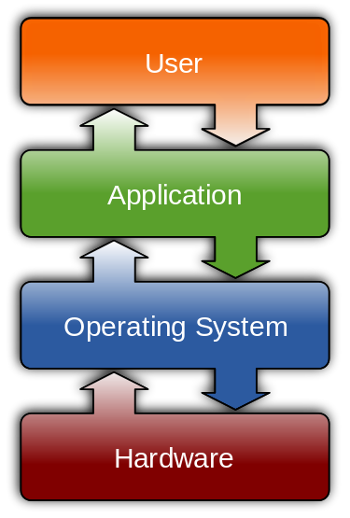
Unix commands
cd - change the working directory
mkdir - make directories
pwd - print name of current working directory
ls – list directory contents
chmod - change the access permissions to files and directories
head - output the first part of files
tail - output the last part of files
more and less display contents of large files page by page or scroll line by line up and down
cat - concatenate files
paste - merge lines of files
wc - print line, word, and bytes for each file
grep - print lines matching a pattern

Slide 3

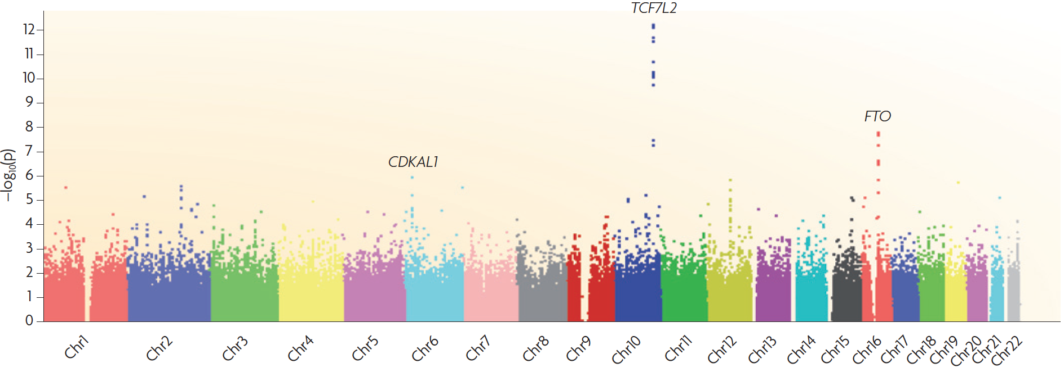
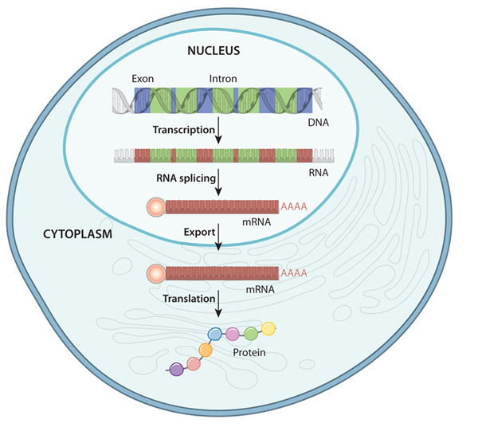
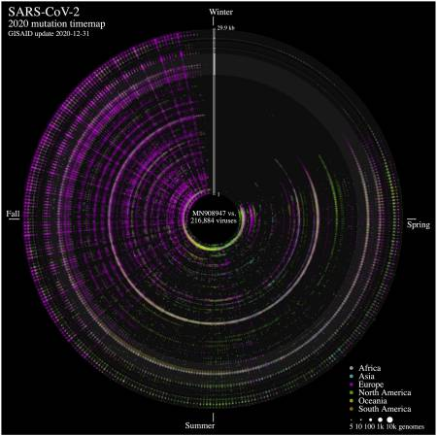

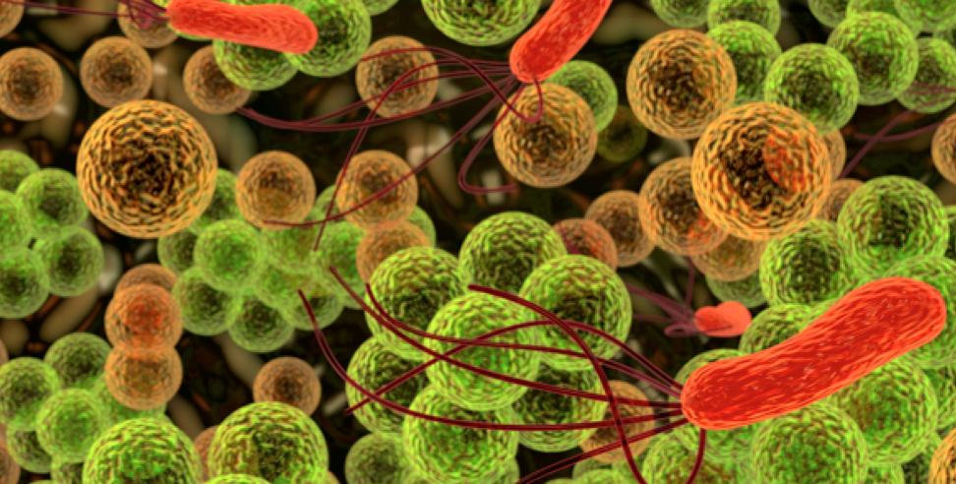
The sequencing technology is key for a wide range of biological researches

Slide 4
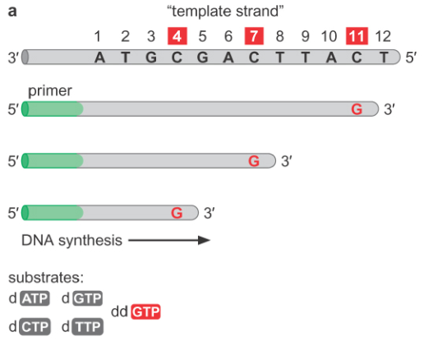
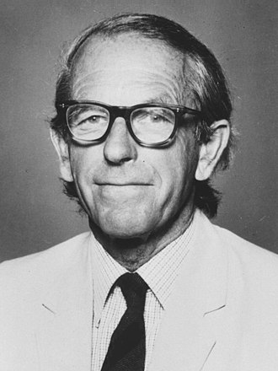
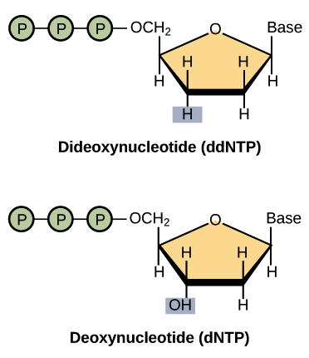
Sanger sequencing technology - I
Frederick Sanger
Key innovation
Notes:
Hydroxide

Slide 5
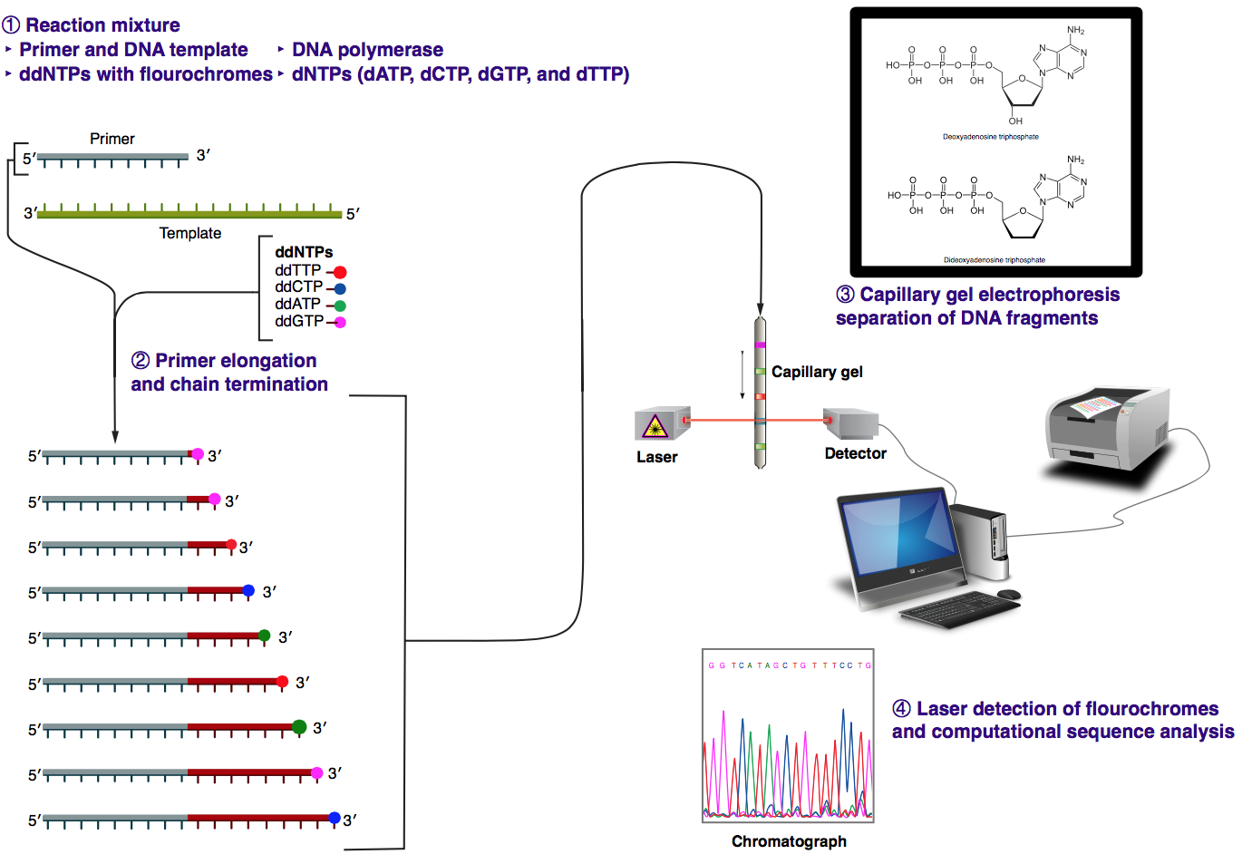
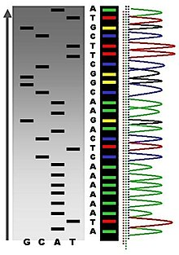
Sanger sequencing technology - II
x
wikipedia
Notes:
Hydroxide

Slide 6





Major Next-gen sequencing (NGS) technologies
Notes:
Jonathan Rothberg (454 + Ion Torrent)

Slide 7
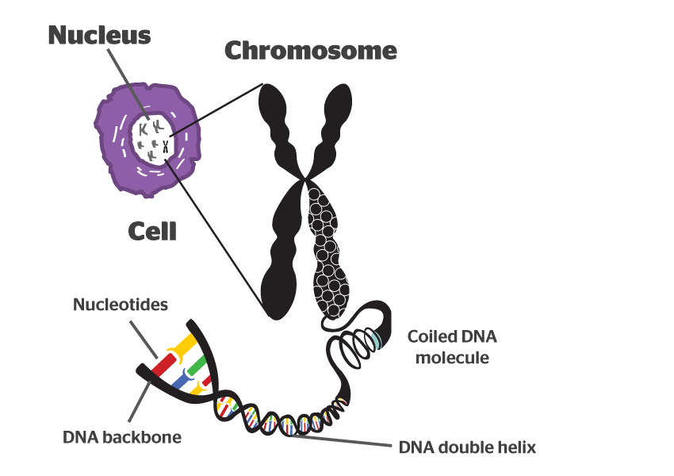
sequencing sensitivity and read length Before single molecular & "super long" sequencing technologies, fragmentation and amplification/cloning of a single nucleotide molecule are needed for sequencing.

Slide 8
COMMON in all NGS platforms
Input
RNA/DNA
adaptor
DNA Library
The adaptor is required for library preparation
Insert
Hundreds to thousands of millions of fragments are sequenced in parallel
Sequencing*
adaptor
Data
Output

Slide 9
Single-molecule and amplification-based approaches
Nucleotide detector: VERY sensitive
Directly read sequence
single-molecule
Nucleotide detector: Not sensitive at the single molecular level
amplify and then read sequence
"Having many thousands of identical copies of a DNA fragment in a defined area ensures that the signal can be distinguished from background noise."

Slide 10
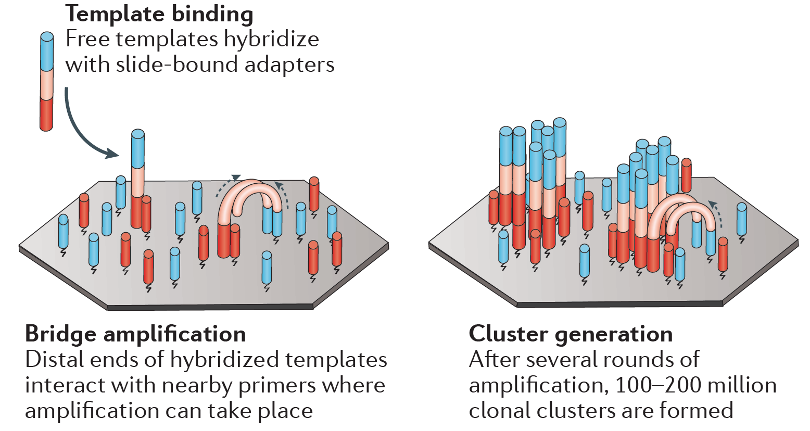
Massive independent amplifications – bridge PCR

Slide 11
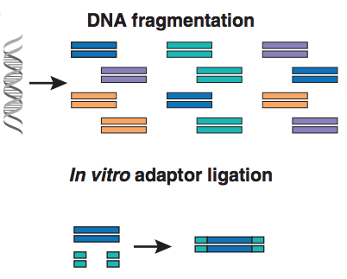
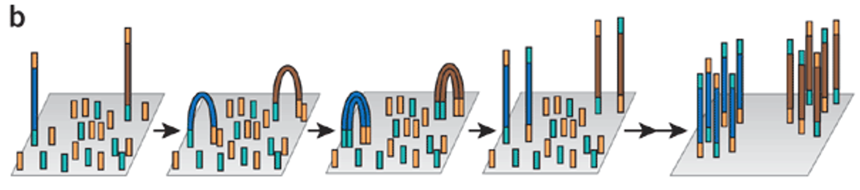
DNA amplification
Adaptor ligation
Bridge PCR on slides
(Illumina)
Nature Biotechnology, 2008, 26: 1135-45

Slide 12
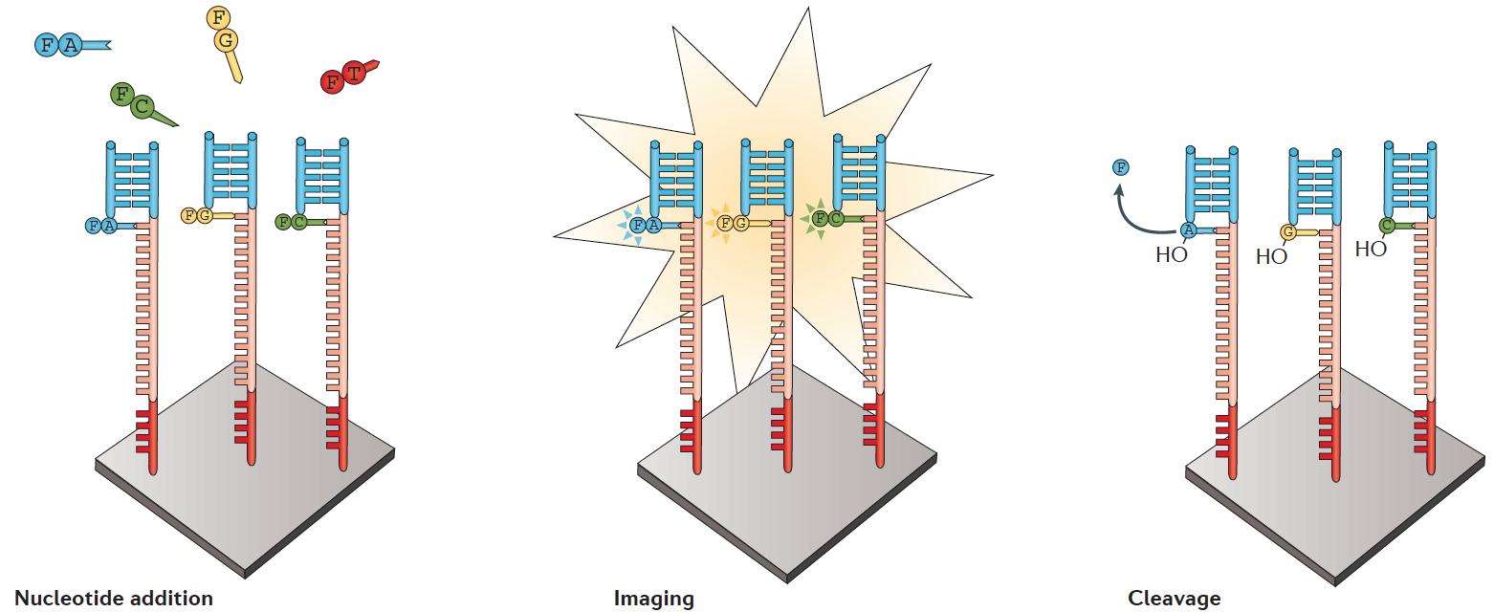
Illumina
Two key technologies:
Bridge PCR
Reversible terminator chemistry

Slide 13
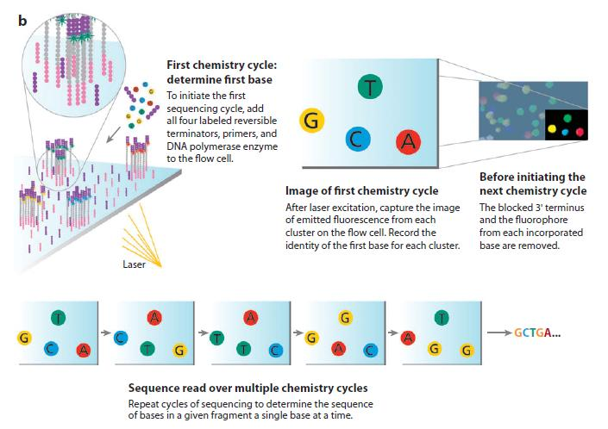
Illumina sequencing

Slide 14
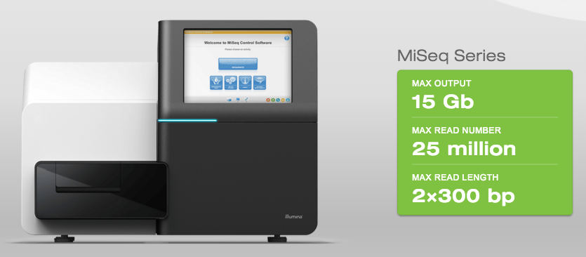
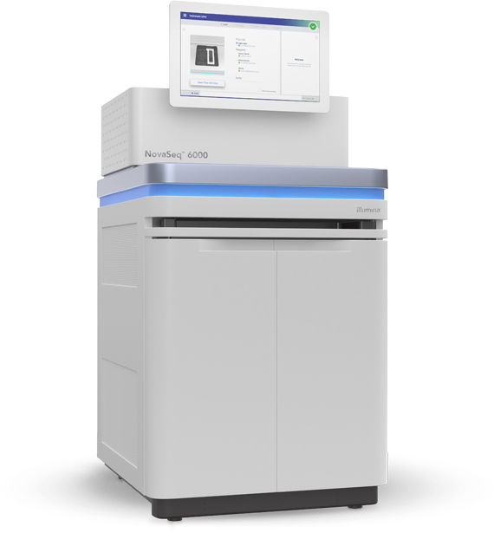
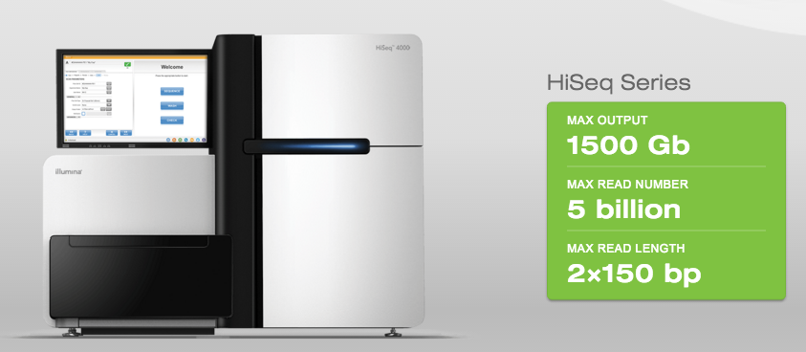
Illumina Sequencers
NovaSeq

Slide 15
When the single molecular sequencing technology is ready, amplification or cloning is not necessary.

Slide 16
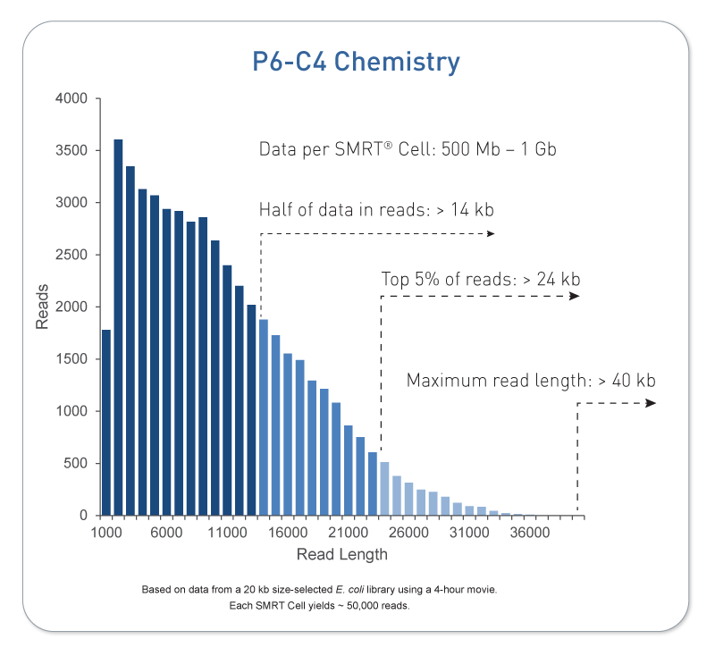
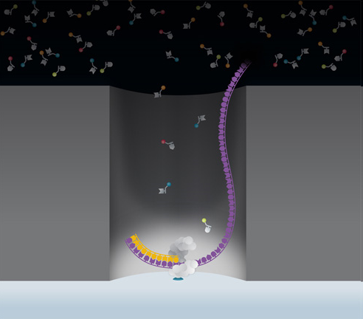
PacBio – Single Molecule Real Time (SMRT)
PacBio tech video
Single molecule sequencing
no amplifications required
up to 70+ kbp sequencing
Moderate sequencing throughput
high sequencing error rate (1-5%, random, no-context-specific errors)
pacbio.com

Slide 17
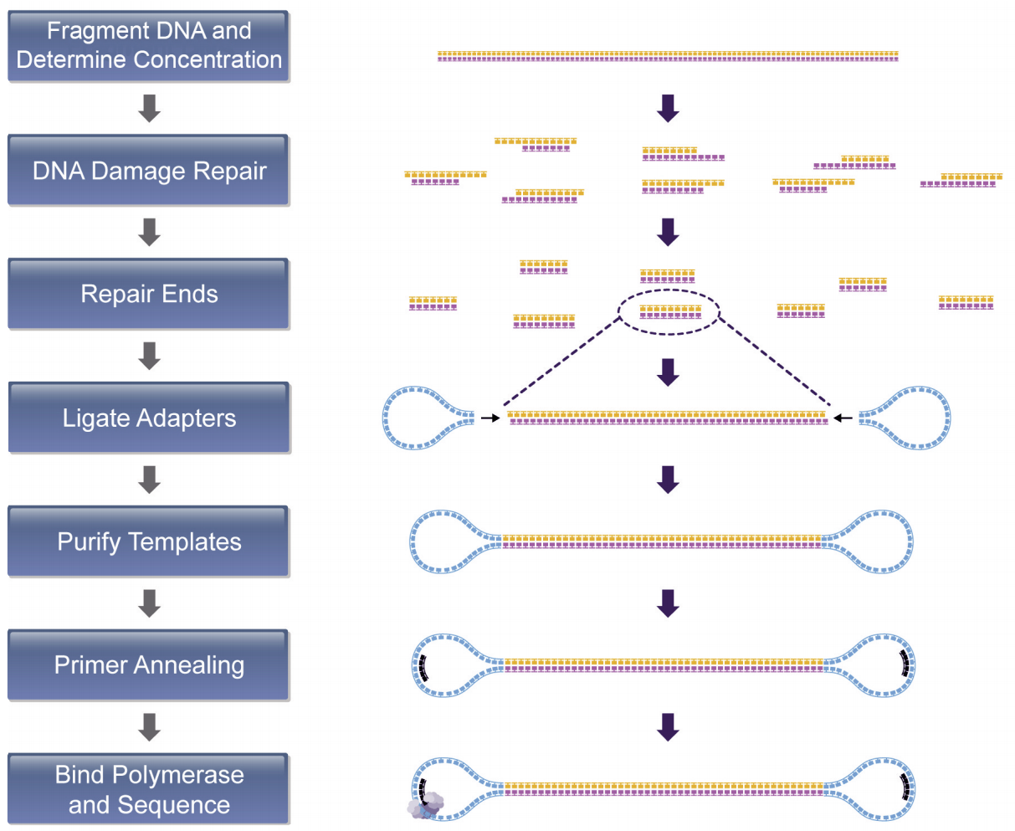
PacBio library prep workflow

Slide 18
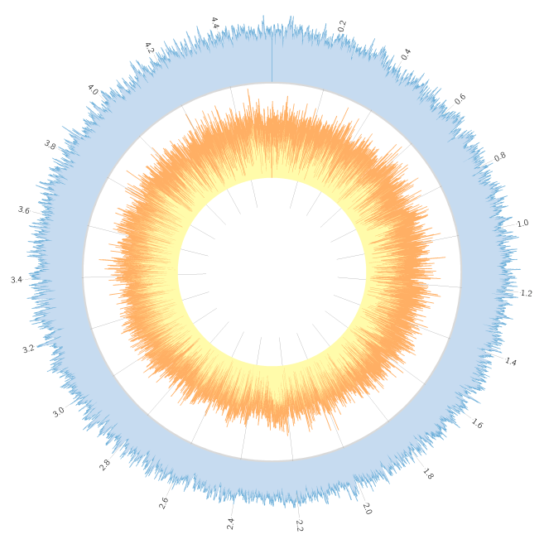
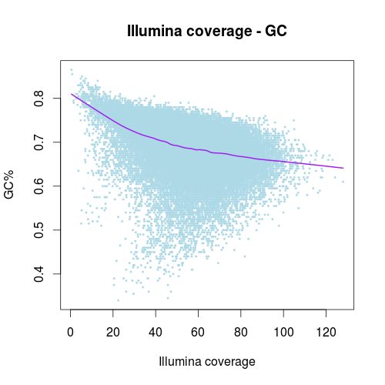
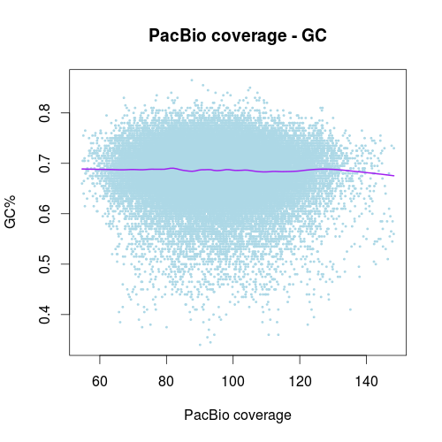
Less biases (e.g., GC)
pacbio
Coverage map (depth per region)
Illumina
Peng et al., BMC Genomics, 2016, 17:21

Slide 19
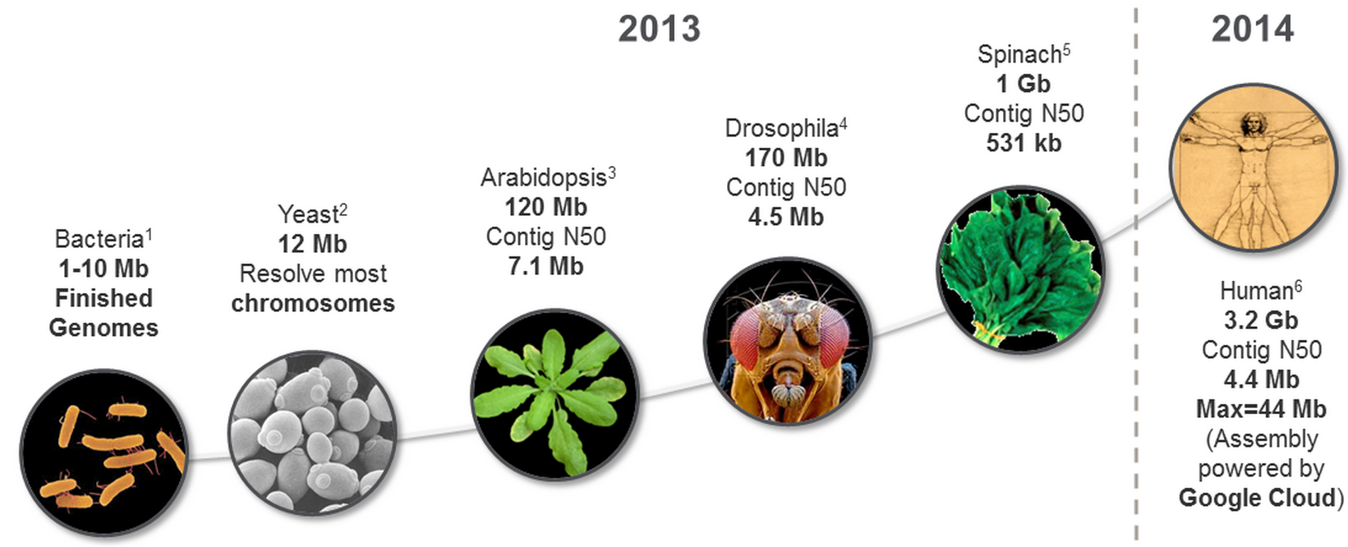
PacBio for genome assembly
PacBio has solved de novo assemblies of most bacterial genomes and it will solve assemblies of small “simple” genomes (e.g., <500 Mbp) with increasing read length and improved sequencing quality.

Slide 20
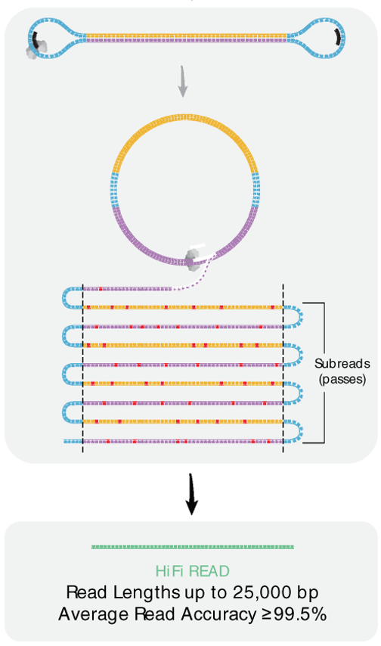
HiFi PacBio data
Up to 25 kb with
~99% accuracy
Scientific Data, 2020, 7:399

Slide 21
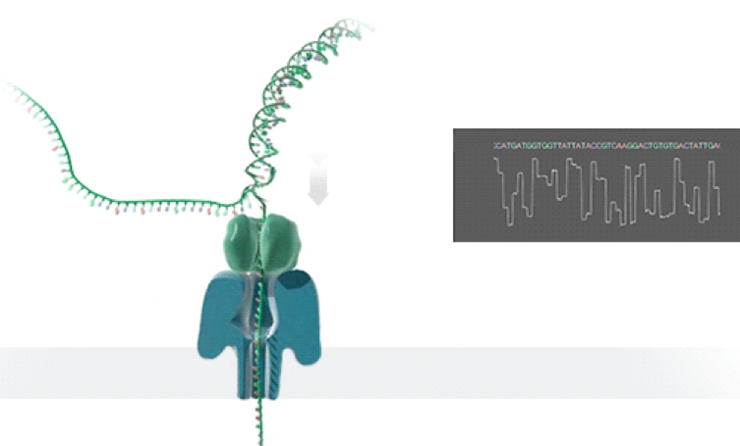
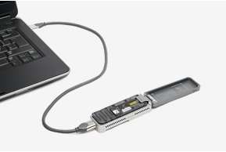
Oxford Nanopore A promising technology
As each nucleobase passes through the pore the current is affected and this change allows sequence to be read out.
Single molecular sequencing
No amplifications
Long reads (typically 10-200kb)
Error rate is high (~1-10%)
Notes:
10

Slide 22
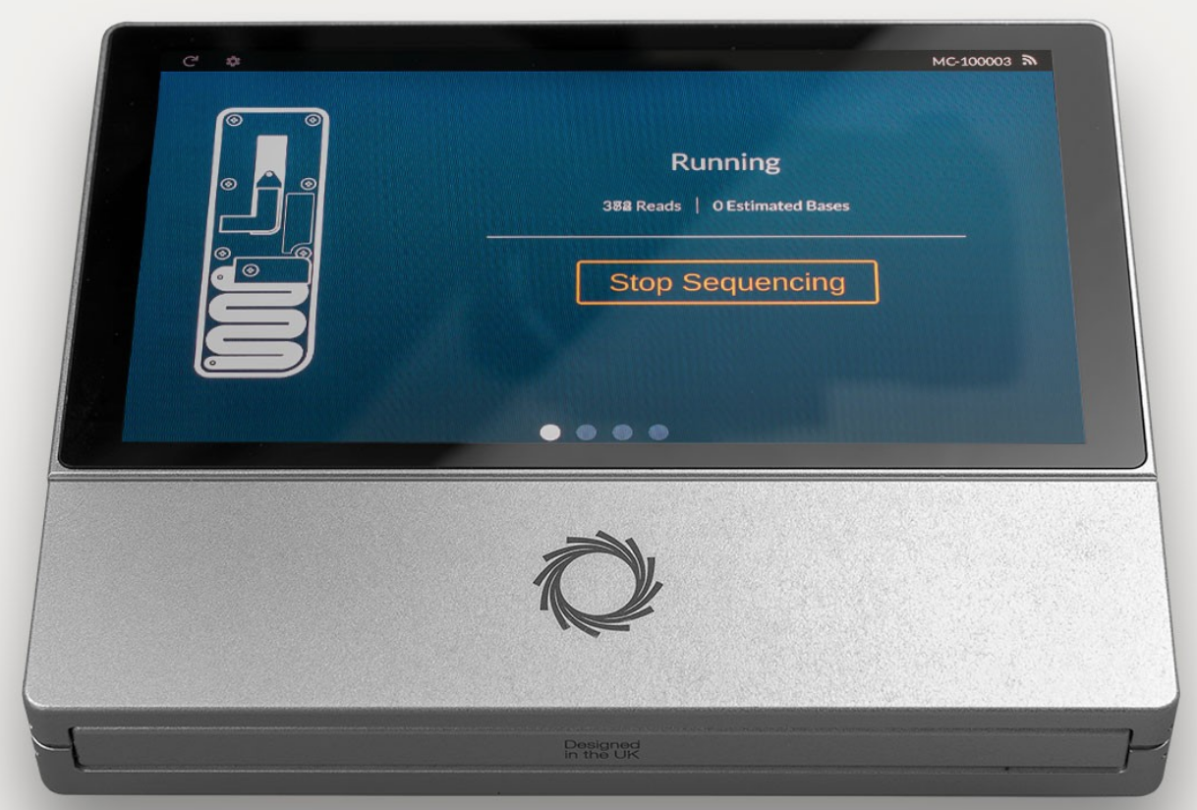
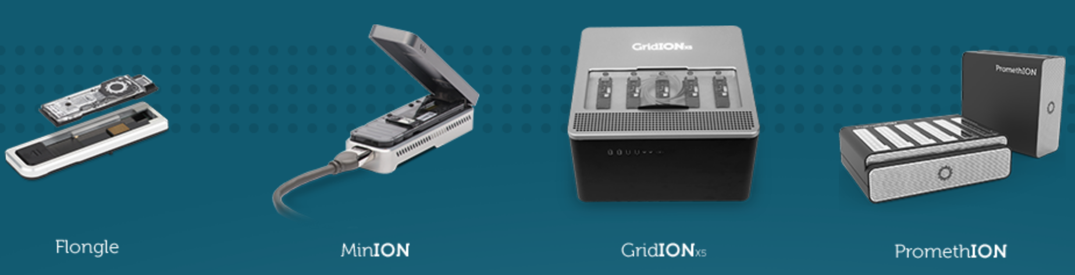
Nanopore devices
MinION
USB disposable sequencer
~10Gb in about two days
PromethlON
High-throughput
lower cost (<$1000 per human genome)
portable device:
MinION Mk1C

Slide 23
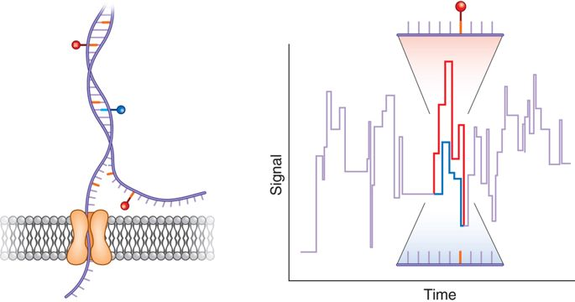
Applications of Nanopore sequencing
1. Genomic DNA sequencing
2. RNA sequencing (direct RNA or cDNA)
3. DNA methylation and other modifications
Nature Methods, 2017, 14:347–348

Slide 24
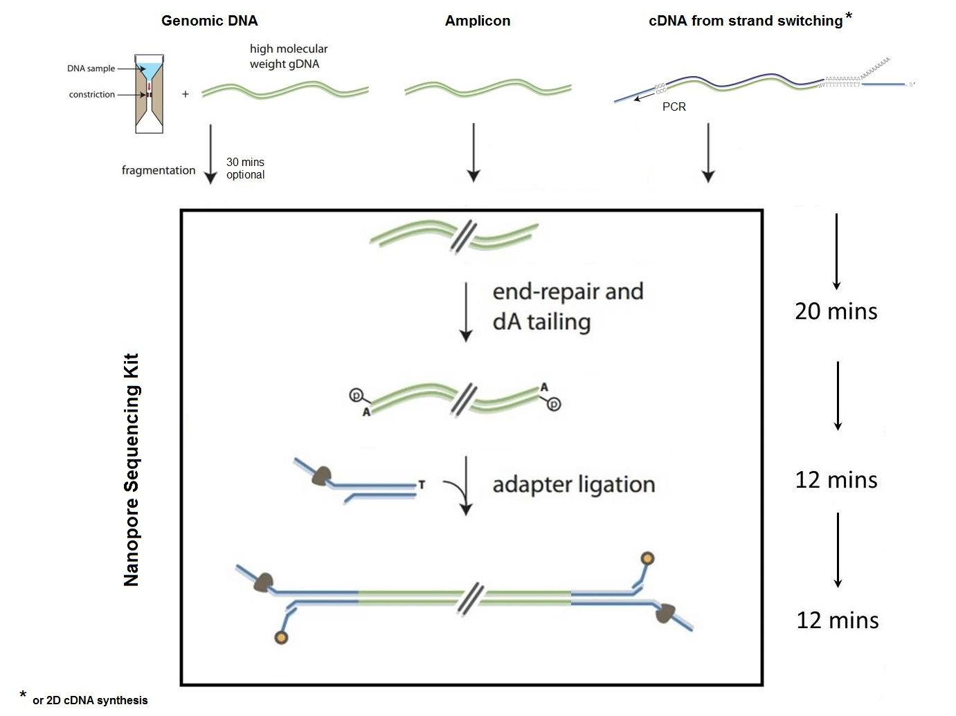
Nanopore library preparation
nanopore.com

Slide 25
COMMON in all NGS platforms
Input
RNA/DNA
DNA Library
Adaptor is required for library preparation
Thousands to hundreds of millions of fragments are sequenced in parallel
Sequencing
Data
Standard data (FASTQ) are output
Output

Slide 26
Sequence errors and read lengths
Nanopore
(InDel)
PacBio
(InDel)
Read length
PacBio-HiFi
Illumina
(substitution)
Sanger
HIGH
LOW
Sequencing Error

Slide 27
Applications of NGS
Whole-genome sequencing/re-sequencing / target-region sequencing (Assembly, Variant discovery)
Genome-reduction sequencing (GBS, RAD-Seq)
RNA-seq: differential expression, alternative splicing and variant discovery
Small RNA-seq
ChIP-Seq: Elucidate DNA-protein interaction
Metagenomics
Others
Notes:
chromatin immunoprecipitation (ChIP)

Slide 28
Case study
De novo assembly of a strain of E.coli
Human whole genome sequencing for SNP discovery
Which platform(s)?
Sequencing depth?

Slide 29
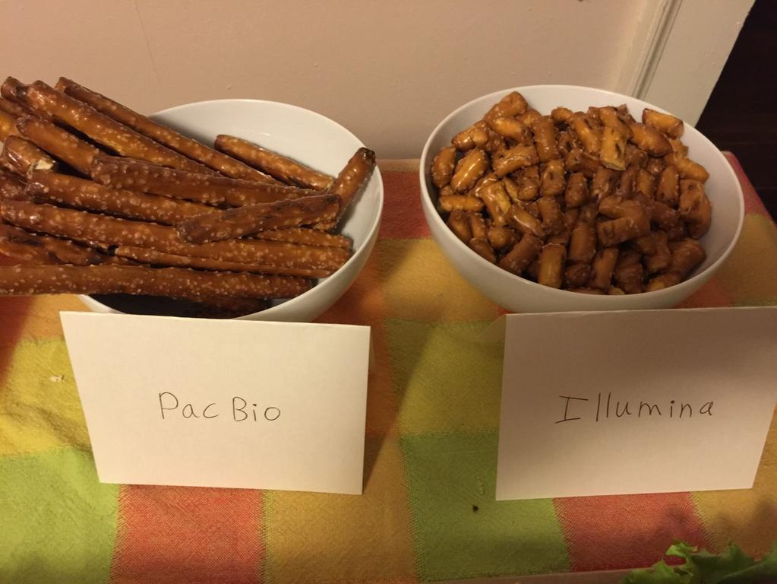
Sequence platforms
Illumina (MiSeq, NextSeq, HiSeq, NovaSeq)
very high throughput, up to 2x300 bp, and high accuracy (<1%)
PacBio
Moderate sequencing throughput, very long (>70kb+), relatively high errors (1-5%)
PacBio HiFi
~15 kb, <1% error
Nanopore
Moderate sequencing throughput, very long (could be >1 Mb), errors (1-10%)
@anne_churchland (twitter)

Slide 30
Experimental design
Goal
Platform
Read length
Rate and type of sequence errors
Sequencing depth
Replication
Control
Budget
Platform | Templates | Signal | Read length | Run time | reads per run | Error type | Error rate
Illumina Miseq | PCR or PCR-free | fluorescent | up to 2x300 | 1-2 days | Up to 10 Gb | substitutions | ~0.1-1%
Illumina Hiseq | PCR or PCR-free | fluorescent | up to 2x250 | days | Hundreds of Gb | substitutions | ~0.1-1%
PacBio (hifi) | Amplification not required | fluorescent | ~10,000 | 30min | 500 Mb – 1 Gb | InDel | <1%
Nanopore | Amplification not required | Electronic flow change | >10,000 | hours | >5Gb per MinION | InDel | 1-10%

Slide 31
COMMON in all NGS platforms
Input
RNA/DNA
DNA Library
Adaptor is required for library preparation
Thousands to hundreds of millions of fragments are sequenced in parallel
Sequencing
Data
Standard data (FASTQ) are output
Output

Slide 32
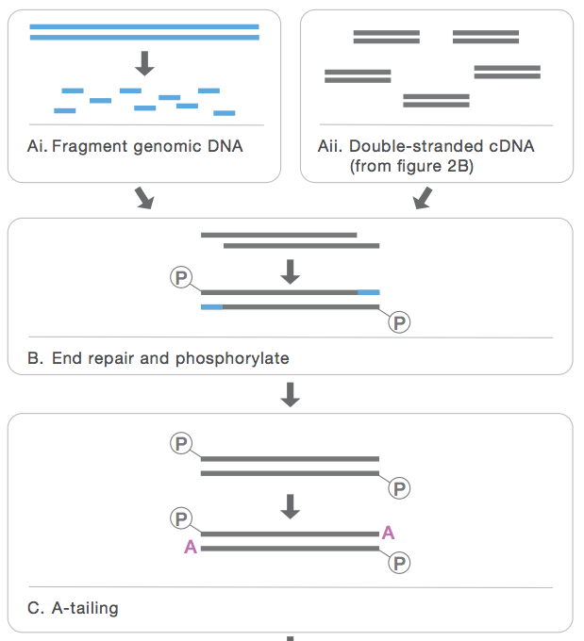
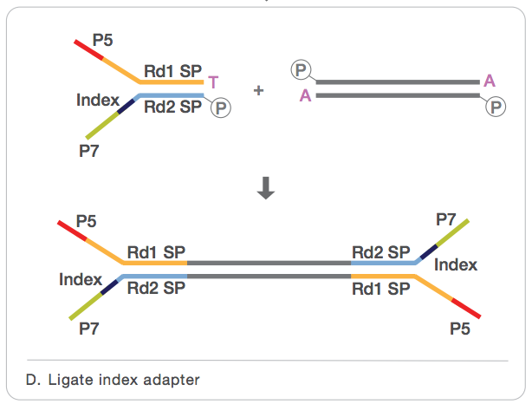
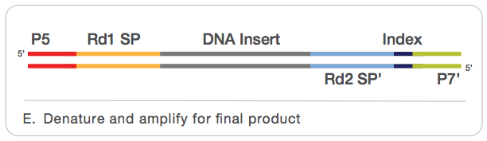
Illumina library preparation – Y-adaptor method
a.
Fragmentation
b.
Y-adaptor
End-repair
PCR or PCR-free
Final product
A-tailing
From TruSeq Manual

Slide 33
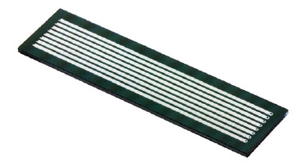
Multiplexing (DNA barcode/Index)
flowcell
lane
• Data from a lane are more than needed in many cases
• Multiplexing: To put multiple samples in a lane via using DNA barcodes to distinguish samples

Slide 34
Barcode / Index
AGTGCAxxxxxxxxxxxx
AGTGCAxxxxxxxxxxxx
AGTGCAxxxxxxxxxxxx
CATGTCxxxxxxxxxxxx
CATGTCxxxxxxxxxxxx
CATGTCxxxxxxxxxxxx
sample 1
sample 2

Slide 35
Single-end sequencing
A single read is generated for each template/cluster
“Read” could be 36-300 bp
typically 200-500 bp
Insert size

Slide 36
Paired-end sequencing
Two reads are generated for each template cluster;
the 1st is from one end with one primer;
the 2nd is for the other end with the other primer.
Read 1
Fix size
Read 2

Slide 37
Illumina platforms and terminologies Illumina video
Library preparation
Sequencing procedure
Single-ends and paired ends

Slide 38
Summary
NGS platforms
Pro and con of each platform
Approaches for library preparation
Applications of various NGS tech

